Slide 1
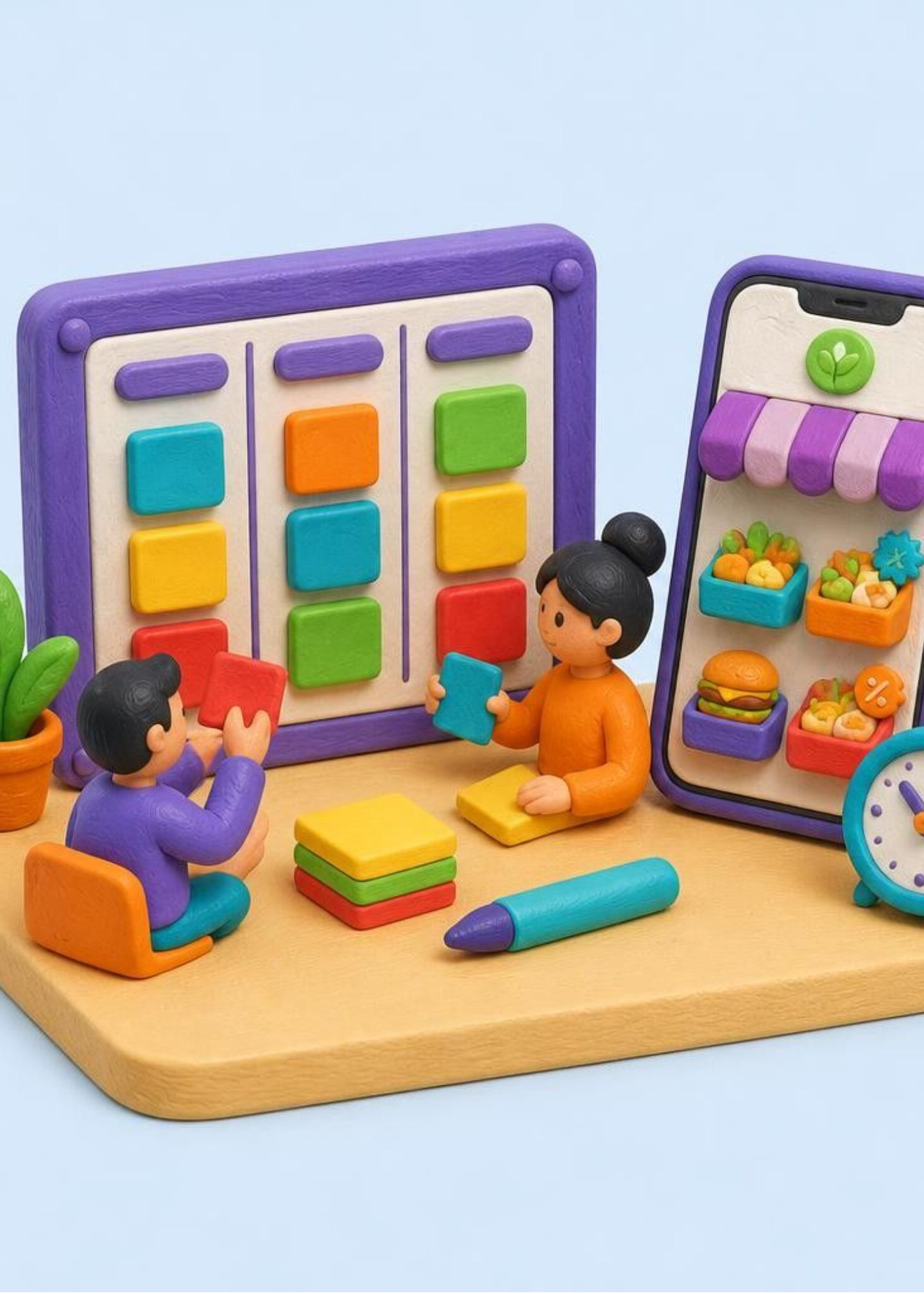
SOFTWARE ENGINEERING
Agile builds software in small, repeated cycles
The Agile Model divides a project into small parts. Each part is developed, tested, and improved through repeated cycles.
Adapts to change: unlike Waterfall's fixed sequence, requirements can change during development
Continuous feedback: customers respond throughout development
Small increments: useful features are released early and improved over time
Real-time example: AI-powered food waste app
A startup builds an app for restaurants to sell surplus food at a discount before it expires. The team releases features in small increments and improves the app from user feedback.

Slide 2
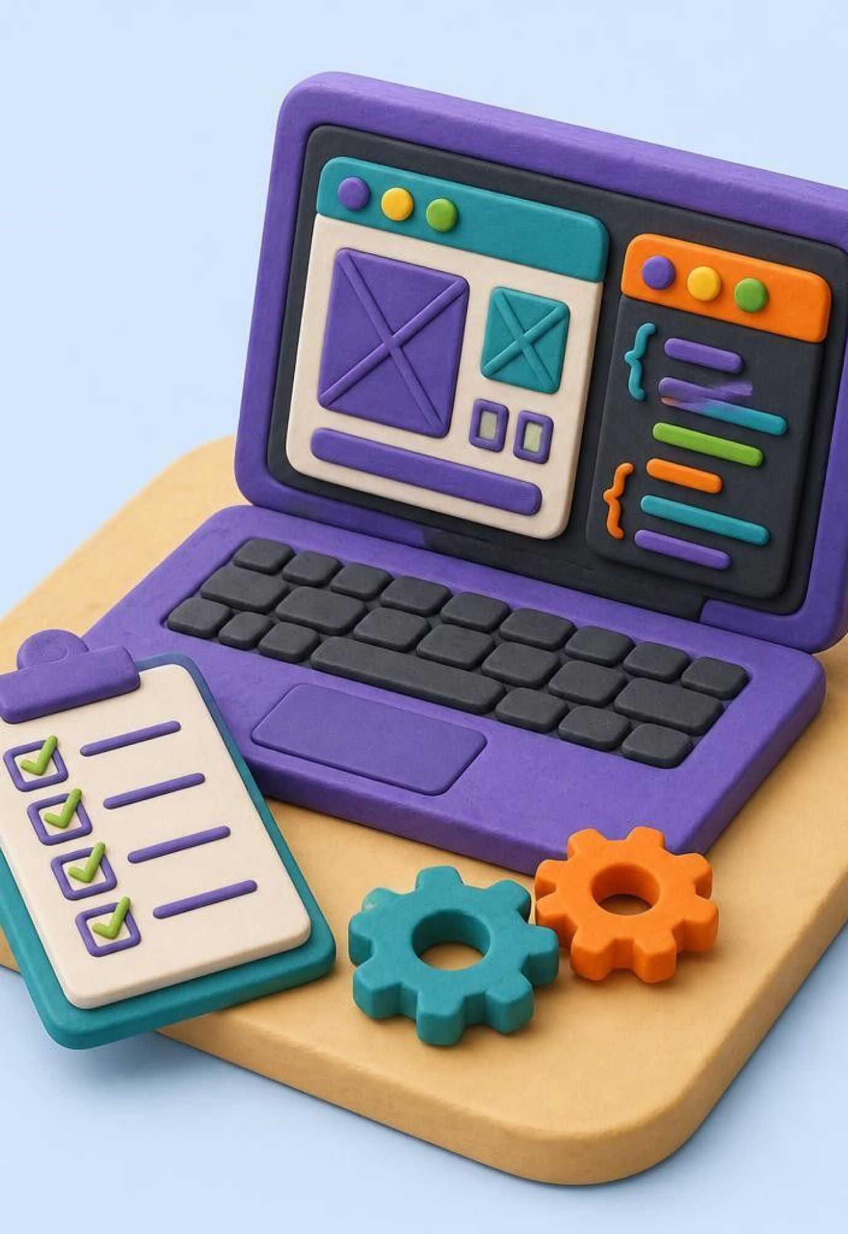
THE PHASES
Phases 1–3: from needs to a working increment
Agile breaks foundational software discovery, architecture, and construction into rapid feedback loops.
1
Requirement gathering
Talk to customers and users, prioritize features.
Example: owners list surplus food, customers find discounted meals, users order.
Output: prioritized requirements and user stories.
2
Design
User flows, wireframes, high-level architecture.
Example: restaurant dashboard, food listing, order page, payment flow.
Output: wireframes, prototypes, design documents.
3
Construction / iteration
Build in short cycles (sprints in Scrum).
Example: Sprint 1 registration/login; Sprint 2 listings; Sprint 3 orders/payment; Sprint 4 tracking.
Output: a working increment each iteration.

Slide 3
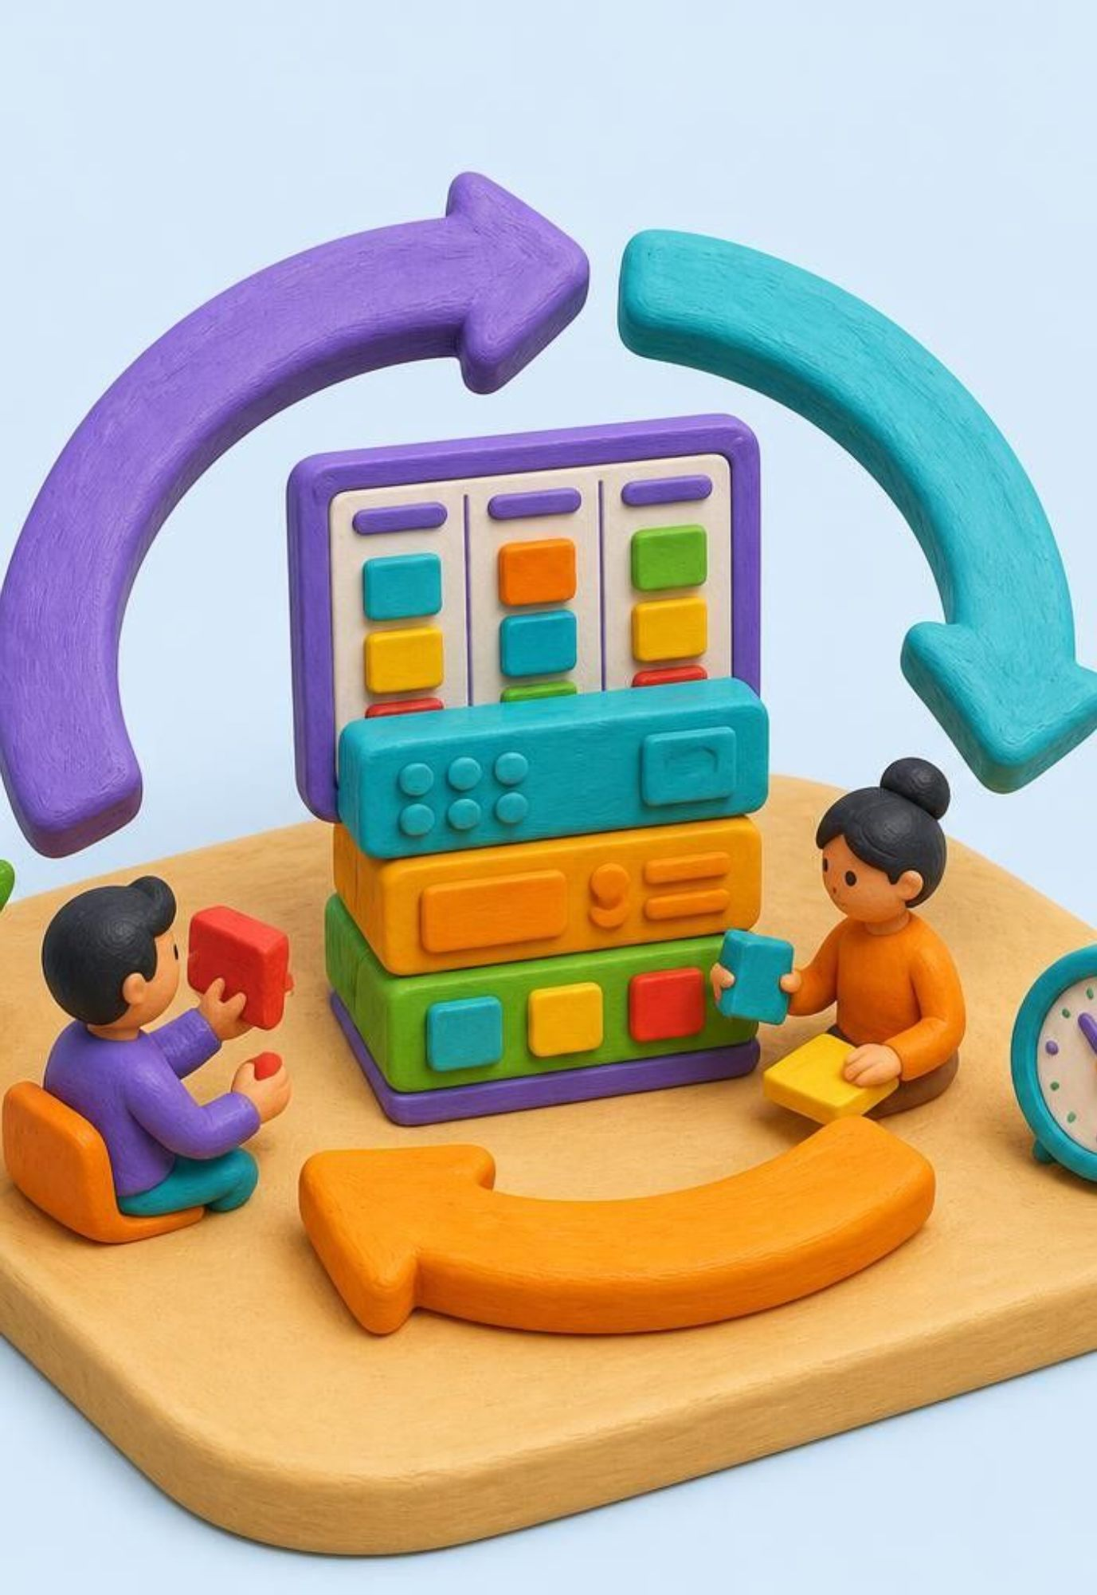
THE AGILE CYCLE
Phases 4–6: verify, release, learn, repeat
Validate each increment with real users and feed immediate insights into the next backlog sprint.
4
Testing / QA
Test while development continues and fix defects as found.
Example: login, correct prices, no orders for unavailable food, payment.
Output: test results, defect reports, verified features.
5
Deployment
Release tested features after each iteration or per release plan.
Example: registration and listings first, ordering and notifications later.
Output: a working product increment for users.
6
Feedback
Collect feedback and update the backlog.
Example: customers want a vegetarian filter; owners want expired listings removed automatically.
Output: updated priorities.
REQUIREMENTS → DESIGN → DEVELOPMENT → TESTING → DEPLOYMENT → FEEDBACK → REPEAT THE CYCLE.

